Slide 1
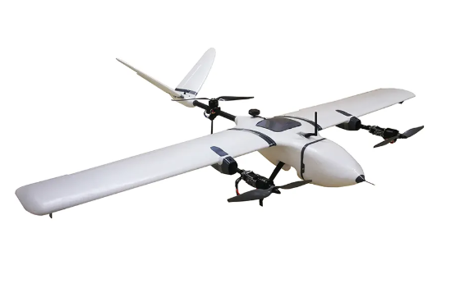
Vertical Take-off Landing (VTOL) Aircraft
Metin Öz Harun Üner
2019405000 2019405207

Slide 2
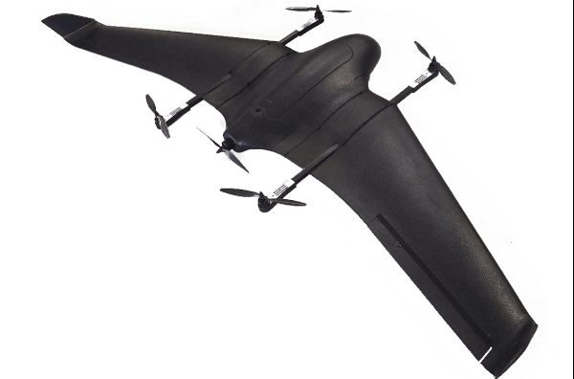
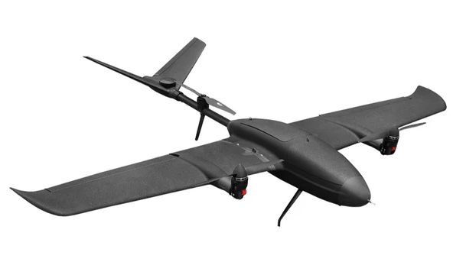
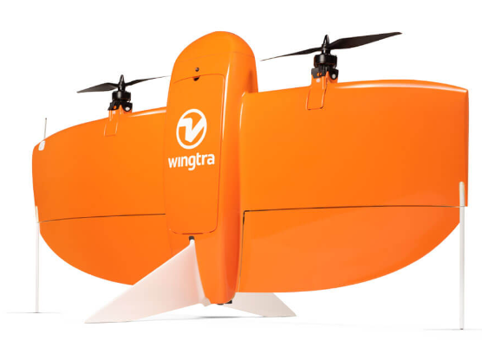
What is VTOL?
-VTOL is a type of aircraft that can take off and land vertically and also perform forward flight like a fixed wing.
-The Types of fixed-wing VTOLs :
Quad-in-Plane VTOL drones
Tail-sitter VTOL drones
Tiltrotor VTOL drones

Slide 3
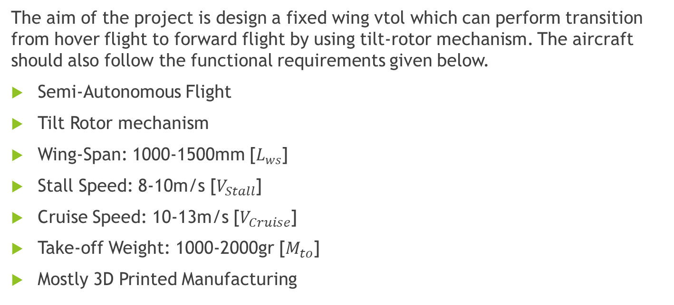
Problem Definition and Functional Requirements :
The aim of the project is design a fixed wing vtol which can perform transition from hover flight to forward flight by using tilt-rotor mechanism. The aircraft should also follow the functional requirements given below.
Semi-Autonomous Flight
Tilt Rotor mechanism
Wing-Span: 1000-1500mm [$L_{ws}$]
Stall Speed: 8-10m/s [$V_{Stall}$]
Cruise Speed: 10-13m/s [$V_{Cruise}$]
Take-off Weight: 1000-2000gr [$M_{to}$]
Mostly 3D Printed Manufacturing

Slide 4
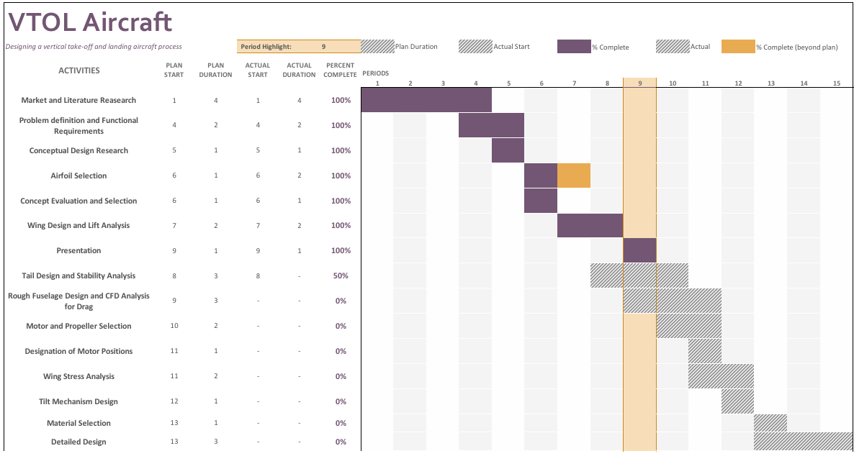

Slide 5
Concepts of Fixed Wing VTOLs
Concept 1
3 rotors
2 front rotors are able to tilt in y-axes
Only 1 (Rear) passive rotor causes extra drag during horizontal flight
Quite Stable for vertical flight (3-point stability triangle)
Less bending moment on wings

Slide 6
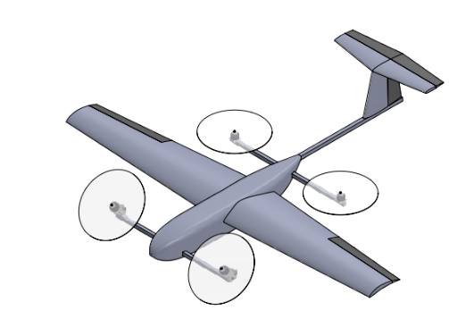
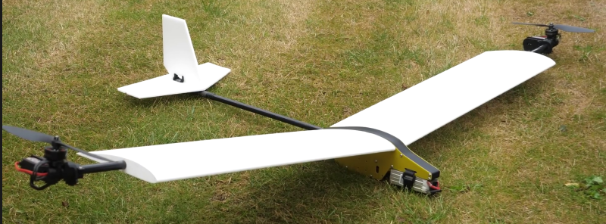
Concept 2
4 rotors, 2 of them (Front) are able to tilt
2 passive rotor causes extra drag during horizontal flight
Extra weight for rotor arm tubes
Most stable concept for vertical flight
Concept 3
2 rotors, both are able to tilt
No passive rotor, no extra drag
Highest bending moment on wing
Least stable concept for vertical flight

Slide 7
Product Design Specification
Maintenance
Size Restriction
Weight Control Stability
Aesthetic
Manufacturability
Reliability
Unusable Rotors
Transition Capabilities
Hover Efficiency
Material Cost

Slide 8
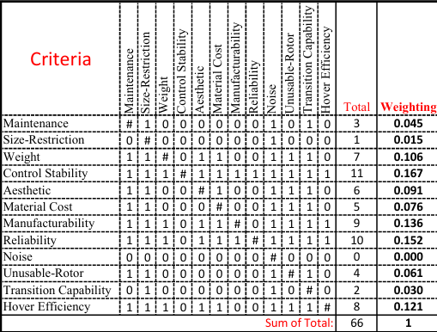
Binary Dominance Matrix

Slide 9
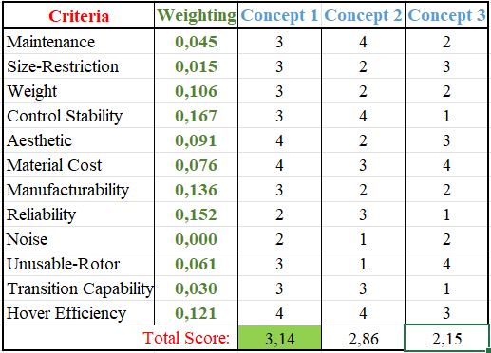
Concept Evaluation

Slide 10
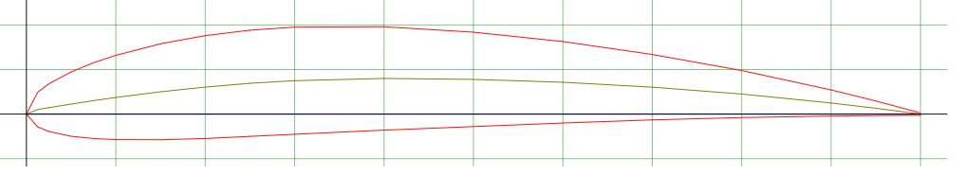
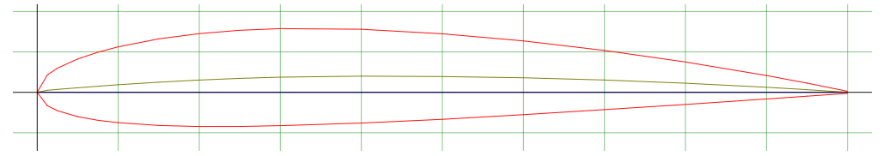
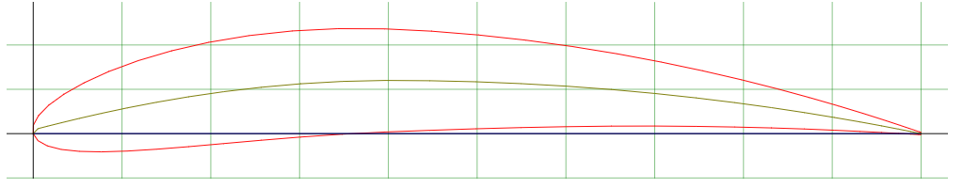

Airfoil Selection
airfoiltools.com web tool is used to select airfoil, compare and understand their strengths for our design.
NACA 4412
NACA 2412
NACA 6412
Low Drag Coefficient
Low Chamber-Ease of Manufacturing
High $C_{L}/C_{D}$ Ratio

Slide 11
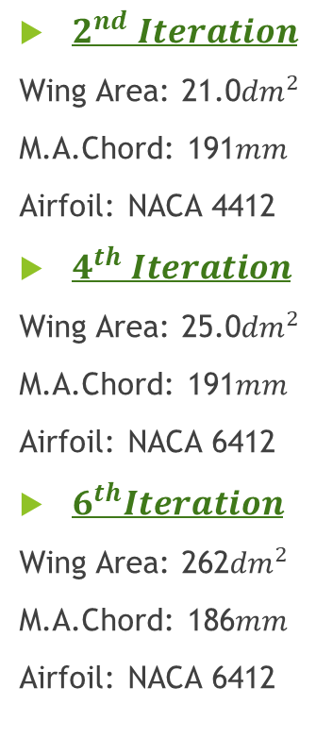
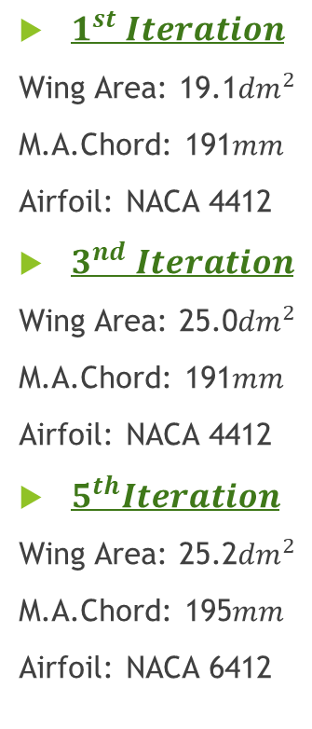

XFLR-5 Wing Design and Analysis
$1^{st} Iteration$
Wing Area: 19.1${dm}^{2}$
M.A.Chord: 191$mm$
Airfoil: NACA 4412
$3^{nd} Iteration$
Wing Area: 25.0${dm}^{2}$
M.A.Chord: 191$mm$
Airfoil: NACA 4412
$5^{th}Iteration$
Wing Area: 25.2${dm}^{2}$
M.A.Chord: 195$mm$
Airfoil: NACA 6412
Increase of wing area
$2^{nd} Iteration$
Wing Area: 21.0${dm}^{2}$
M.A.Chord: 191$mm$
Airfoil: NACA 4412
$4^{th} Iteration$
Wing Area: 25.0${dm}^{2}$
M.A.Chord: 191$mm$
Airfoil: NACA 6412
$6^{th}Iteration$
Wing Area: 262${dm}^{2}$
M.A.Chord: 186$mm$
Airfoil: NACA 6412
Increase of wing area
Change to higher $C_{L}Airfoil$
Increase of Root Chord
Addition of winglets

Slide 12
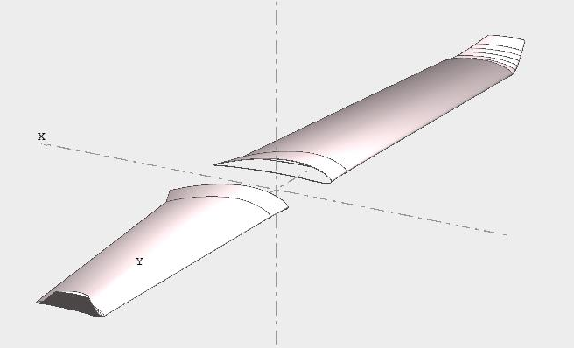
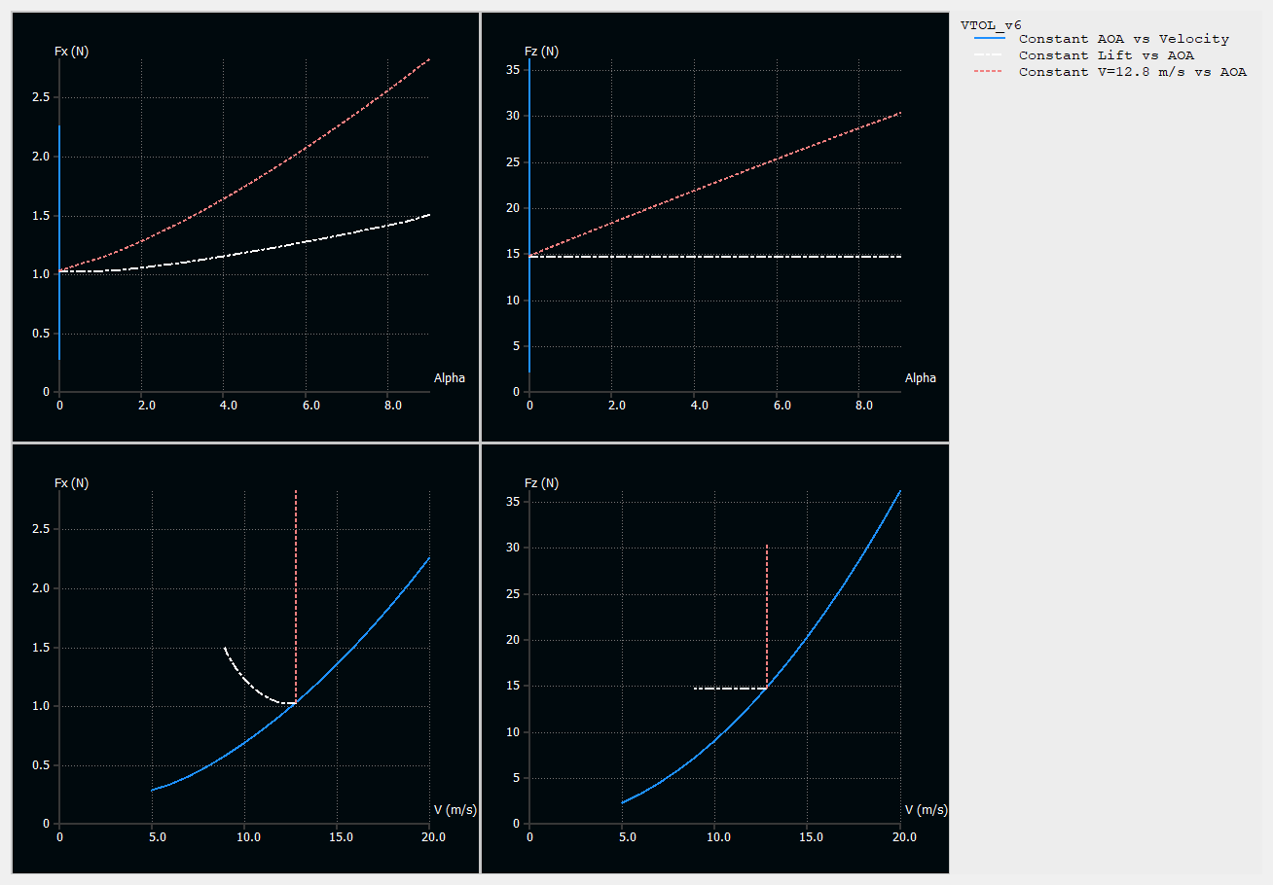
Final Design and Results
XFLR-5
6 Iteration is performed for
different geometries
Final Iteration:
-Wing Span: 1640mm
-M.A.C: 186mm
-Stall Speed: 8.9m/s @ α=9˚
-Cruse Speed: 13m/s @ α=0˚
(for 1500 g take-off weight)

Slide 13
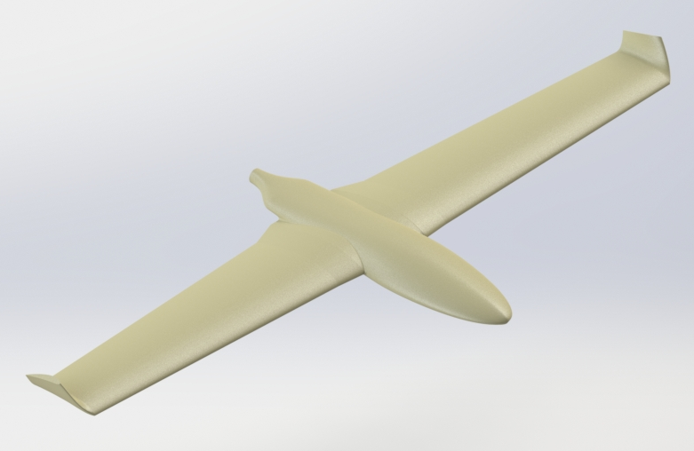
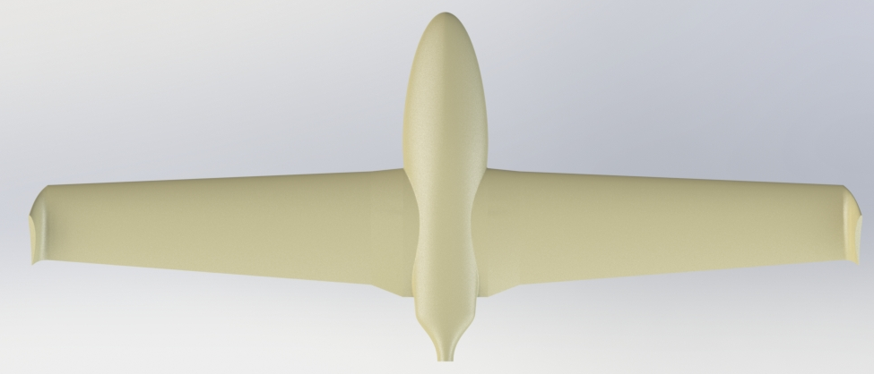
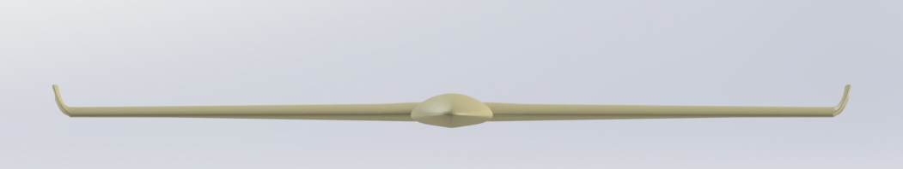
Furthermore

